Slide 1
Strange Wedding Traditions
Team 6 Salwa Sayed Mohamed Saied Amany Hesham

Slide 2
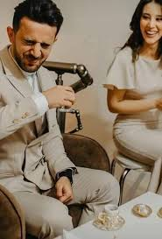
Coffee with Salt

Slide 3
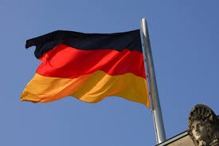
Polterabend
It is a traditional pre-wedding custom that takes place one or two days before the wedding ceremony.
Guests break porcelain dishes (not glass). This act is believed to bring good luck to the bride and groom.
They must clean up the broken pieces together ➔ they will be able to overcome any challenges they face in married life.

Slide 4
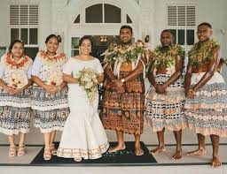
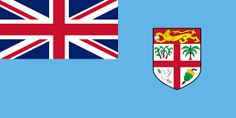
Tabua
There is a traditional custom called “Tabua”, which involves presenting a whale’s tooth (usually from a sperm whale).
The whale’s tooth is a highly valued and sacred symbol in Fijian culture.

Slide 5


About Fiji
An island country located in the South Pacific Ocean
Near Australia and New Zealand
Capital city: Suva

Slide 6
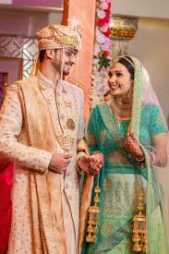
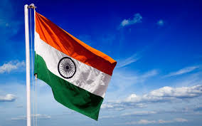
Stealing the Groom’s Shoes (Joota Chupai)
Joota Chupai is a well-known custom in Indian weddings, especially in North India.
During the ceremony, the groom removes his shoes, and the bride’s sisters or female relatives secretly steal and hide them.

Slide 7
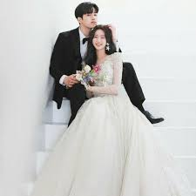
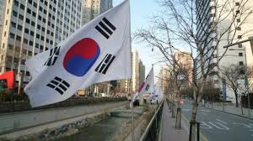
Beating the Groom’s Feet in
There was an old wedding prank sometimes compared to a “Falaka-style” tradition.
After the ceremony, the groom’s friends would tie his ankles and lightly hit the soles of his feet—sometimes even with a dried fish.

Slide 8
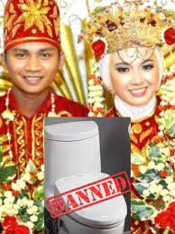
Malaysia & Indonesia – Bathroom Ban Tradition
In the Tidong tribe of Malaysia and Indonesian Borneo, the bride and groom are not allowed to leave their house or use the bathroom for three days after the wedding. They are closely monitored and allowed only small amounts of food and drink. Breaking this tradition is believed to bring bad luck, divorce, or even harm to their future children.

Slide 9
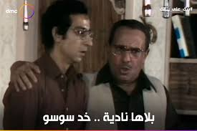
Australia – Marriage by Chance
In some Australian tribes, when a young man proposes, a large celebration is held. The family may offer him any girl from the house — either the one he chose or possibly her sister. Marriage in this case depends largely on luck.

Slide 10
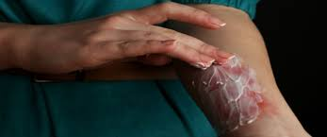
South India – The Groom’s Pain Test
In a town in South India, the bride tests her groom by taking him to the forest and burning his bare back. If he shows pain or complains, she rejects him and may even shame him publicly. If he endures the pain, he is considered worthy of marriage.

Slide 11
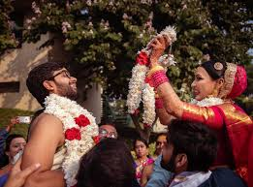
India (Tamil Brahmin) – The Groom Changes His Mind
In Tamil Brahmin weddings in India, the groom pretends that he has changed his mind and wants to live as a monk instead of getting married. His father then convinces him to return and complete the wedding ceremony.

Slide 12
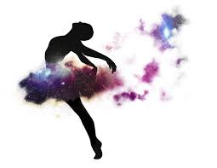
Sudan – The Falling Dance Test
In some Sudanese weddings, the bride intentionally falls during the dance several times. The groom must catch her each time. If he fails, he may feel embarrassed in front of the guests.

Slide 13
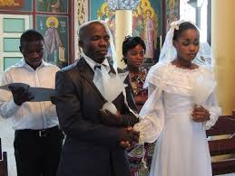
Congo – No Smiling at the Wedding
In the Republic of Congo, the bride and groom are not allowed to smile during the wedding ceremony. Smiling is considered a sign that they are not serious about marriage.

Slide 14
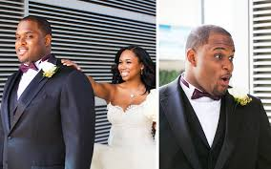
China – Seeing the Bride for the First Time
In some parts of China, the bride and groom do not see each other before engagement. After agreement, the bride is placed in a covered sedan chair and taken outside the town. The groom receives the key, opens it, and sees her for the first time. If he approves, he takes her home; if not, she returns to her family.

Slide 15
Bride Kidnapping Tradition
Before the wedding, friends of bridegroom temporarily 'kidnap' the bride.

Slide 16

Russia
The groom must pay a symbolic ransom to get her back.
Purpose: Fun, proving the groom’s courage, and enhancing celebration spirit.

Slide 17
Breaking Plates Tradition
Friends and family break old plates in front of the couple’s door.

Slide 18
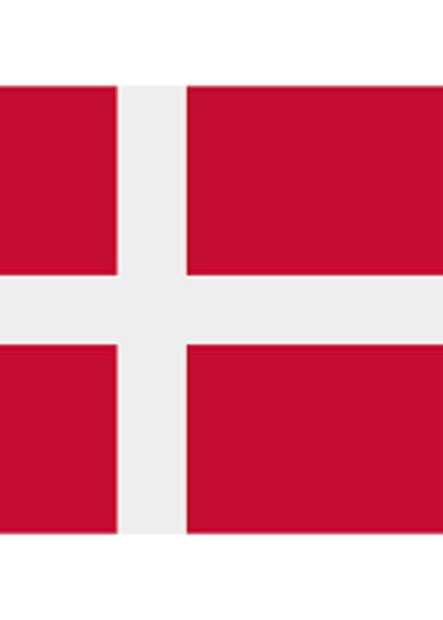
Denmark
Purpose: Bring good luckand protect the couple fromevil spirits.​
More broken plates mean more luck!​
This tradition is unique andsurprising to manycultures.

Slide 19
Collective Crying Ritual
Before the wedding, the bride cries with her mother and family.

Slide 20

China
Crying expresses happiness, gratitude, and love for the family.​
It may seem strange to us, but it is an important cultural tradition.

Slide 21
Blackening the Bride
Friends and family throw dirty things like mud or spoiled food at the bride.

Slide 22

Scotland
Purpose: Prepare the bride mentally for challenges in married life.​
It may seem strange, but it helps buildstrength and resilience.

Slide 23
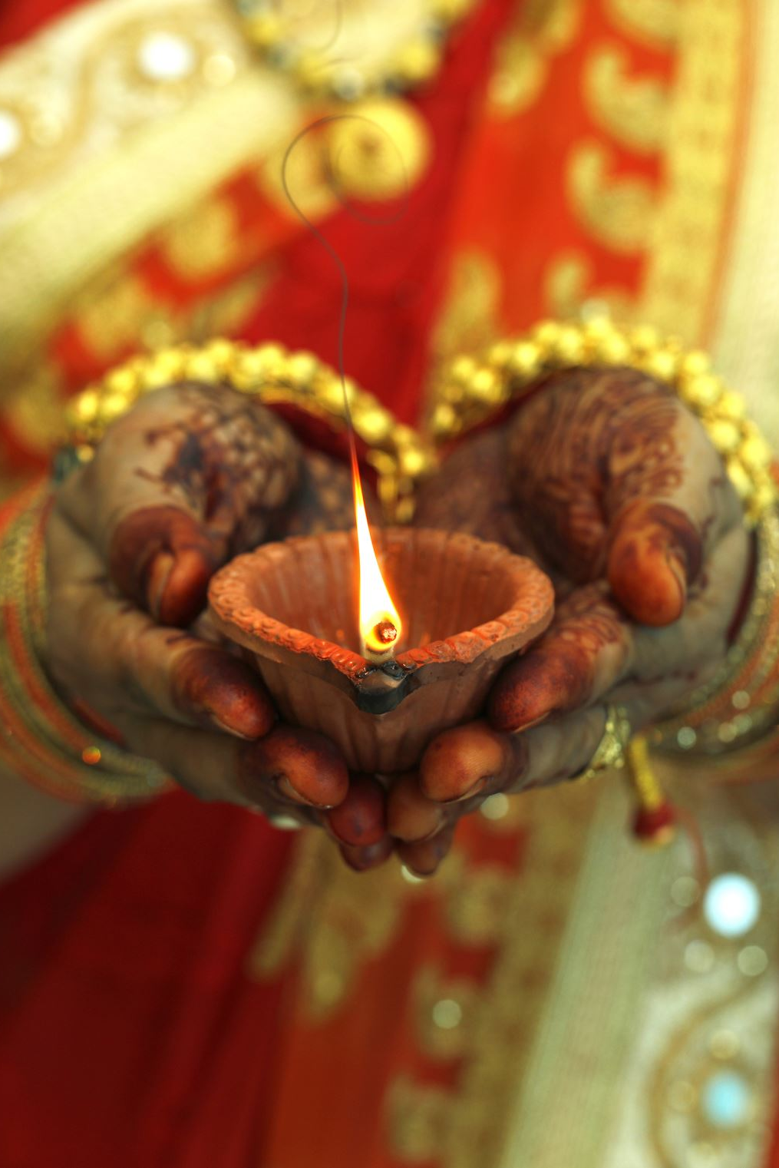
Conclusion
Wedding traditions reflect cultural values and beliefs.
Some traditions may seem strange, but they have deep meanings.
These traditions bring fun, strength, and emotional connection.

Slide 24

Thank you

